Slide 1
Relational Database Schema Design For Uncertain Database
Team Members :
Neerab
Rohit
Rahul

Slide 2
Motivation
Relational databases were developed for applications with certain data, such as accounting, inventory, and payroll. Modern applications such as information extraction, data integration and cleaning, require techniques for uncertain data.
If data is uncertain, then so is any redundancy that results from this data. The more possible it is for data redundancy to occur, the more FDs can cause this redundancy, and the harder the normalization effort will be to remove that redundancy.
Therefore, the impact we expect uncertainty to have on schema design is that the more frequent updates are likely to be processed efficiently with less normalization effort.

Slide 3
Problem statement
Given a Relational Schema(R), Possibility Degree (or) Certainty degree scale(S), set of possibilistic functional dependencies, we have to output the redundancy free, lossless, dependency preserving schema as output.

Slide 4
PFDs
The paper introduces possibilistic FD’s as classical FD’s with a degree of certainty.
As FD’s are fundamental to Relational Database Design, pFD’s will play a fundamental role to schema design for uncertain data.
The Certainty with which an FD holds in an Uncertain relation corresponds to the possibility of the smallest possible world in which the FD is violated.

Slide 5
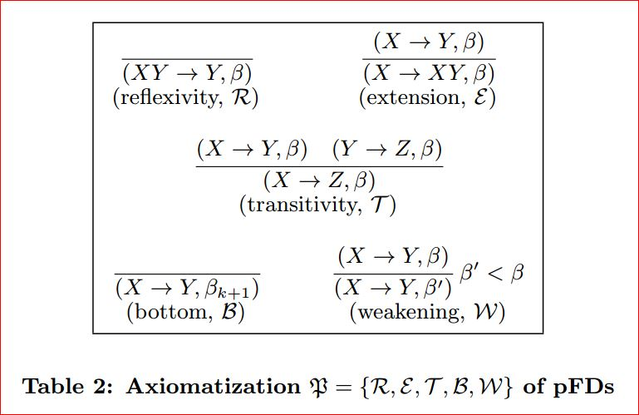
Scaled armstrong’s axioms
This sound and complete axiomatization can be used to solve the implication problem

Slide 6
Scaled normal forms
In p-relations, different data can occur with different p-degrees. Therefore, data redundancy may occur with different p-degrees, too.
Intuitively, the smaller the p-degree for which data redundancy is to be eliminated, the smaller the normalization effort will be.
We will introduce notions of data redundancy that are tailored to the p-degree of tuples in which they occur.
We then characterize each of these semantic normal forms by a corresponding syntactic normal form, and establish strong correspondences with BCNF and 3NF in relational databases.

Slide 7
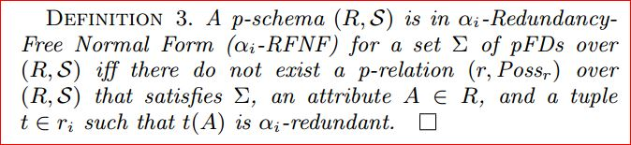

Scaled data redundancy

Slide 8
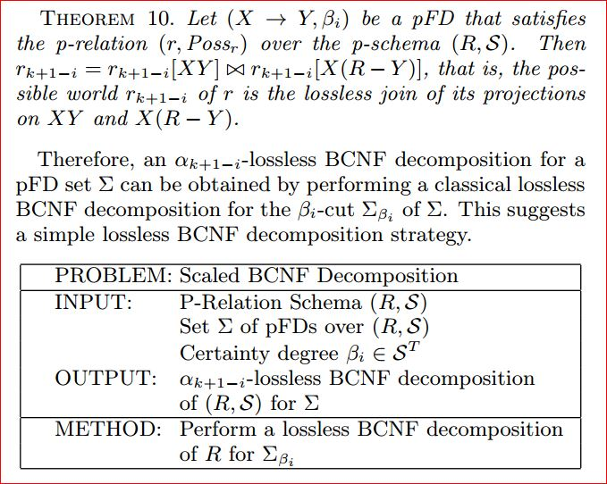
Scaled normalization
Scaled BCNF Decomposition :
Theorem 7 (R; S) is in β-BCNF with respect to a set Σ if and only if R is in BCNF with respect to Σβ.

Slide 9
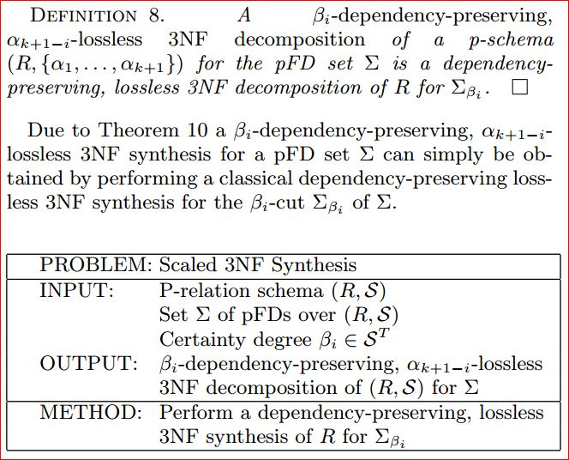
Scaled normalization cont...
Scaled 3NF Decomposition
Theorem 10 (R; S) is in β-3NF with respect to a set Σ if and only if R is in 3NF with respect to Σβ.

Slide 10
β-Bcnf Decomposition
For β-BCNF :
For each beta_{i}(pfds of one world) :
Compute canonical cover of pfds (R₁)
Define D (empty set of relations), LS (empty set of pfds)
Check whether pfds in cover is in bcnf form or not
For each pfd in Σ:
If (violates bcnf) :
Append given pfd to LS.
do
For every pfd in LS:
Perform an (α k+1-i)lossless BCNF decomposition for a pFD set Σ i.e, by performing a classical lossless BCNF decomposition for the βi-cut Σβi of Σ.
Append obtained decomposition's to D,remove given pfd from LS and recursively check if D is in bcnf
While (LS is not empty)
Remove pfds which are there in LS from R₁.
Output (R₁ + D(Set of decompositions))

Slide 11
β-3nf Decomposition
For β-3NF :
For each beta_{i}(pfds of one world) :
Compute canonical cover of pfds (R₁)
Define D (empty set of relations), LS (empty set of pfds)
Check whether pfds in cover is in 3-NF form or not
For each pfd in Σ:
If (violates 3-NF) :
Append given pfd to LS.
Do
For every pfd in LS:
Perform (α k+1-i)-lossless, (βi)-dependency-preserving 3NF synthesis for a pFD set Σ i.e, by performing a classical lossless 3NF synthesis for Σβi.
Append obtained decomposition's to D,remove given pfd from LS and recursively check if D is in 3nf
While (LS is not empty)
Remove pfds which are there in LS from R₁.
Output (R₁+ D).

Slide 12
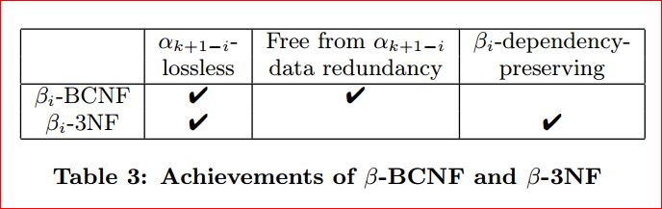
results

Slide 13
Thank You

